Slide 1

MLP 2013
Professionalism Toolbox
The Art & Science
By Jacqueline Coleman, M.Ed, MSM
July 8, 2013

Slide 2

The Art & Science of Professionalism
By the end of this workshop series, participants will be able to:
  Define professionalism and its attributes
  Determine his/her own distinct professional style and techniques
  Successfully apply his/her techniques in their work environments.

Slide 3

The Art & Science of Professionalism
Buzz Group -
What is professionalism in your view?

Slide 4
Core Competencies
pro·fes·sion·al·ism /prəˈfeSHənlˌizəm/
Noun
The competence or skill expected of a professional.
The practicing of an activity, esp. a sport, by professional rather than amateur players.

Slide 5
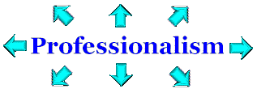
Responsibilities | Characteristics | Criteria
Expectations |  | Education
Competencies | Support | Issues

Slide 6
What is Professionalism?
Professionalism…
  it’s an attitude
  the way in which an individual conducts oneself in certain situations
  the way you speak, the way you dress, the way you are organized, etc.
  It is setting standards and complying with them

Slide 7

Why Does Professionalism Matter?
http://www.youtube.com/watch?v=2PIplMOIINg
  http://www.youtube.com/watch?v=FsimbWV7Ek0

Slide 8

Individual Professionalism Values...
Tolerance
Passion for excellence
Team cooperation & leadership
Competence
Respect and trust

Slide 9
Professionalism is for Everyone
You can evaluate your own professionalism on Character, Attitude, Excellence, Competency, and Conduct based on these five keys:
  Character is who you are and what you stand for. Professionals choose to be professional. They have integrity and they are responsible, diligent, and ethical. They do what is right and project a professional image.
  Attitude is your mental outlook. Professionals have a professional approach and a positive, serving mentality. They seek responsibility and are determined. Professionals are team players.
Source: James R. Ball, 2009

Slide 10
Professionalism is for Everyone [cont.]
  Excellence is your commitment to quality. Professionals press for excellence and continuous improvement. They are attentive and follow instructions.
  Competency is your degree of expertise. Professionals understand their jobs and develop their skills. They produce results, perform effectively, and communicate skillfully.
  Conduct is how you deal with others. Professionals are mature, polite, and loyal. They respect authority and maintain confidences. Professionals do everything with style and class.
Source: James R. Ball, 2009

Slide 11
Professionalism is for Everyone
Do…
  Make the commitment to continually grow.
  Take pride in yourself and your work.
  Deliver on time.
  Get as much done as possible in the allotted time.
  Put passion into your work.
Don’t...
  Settle for mediocrity.
  Blame others or seek excuses.
  Forget to practice skills.
  Turn in work that is incomplete or inferior.

Slide 12
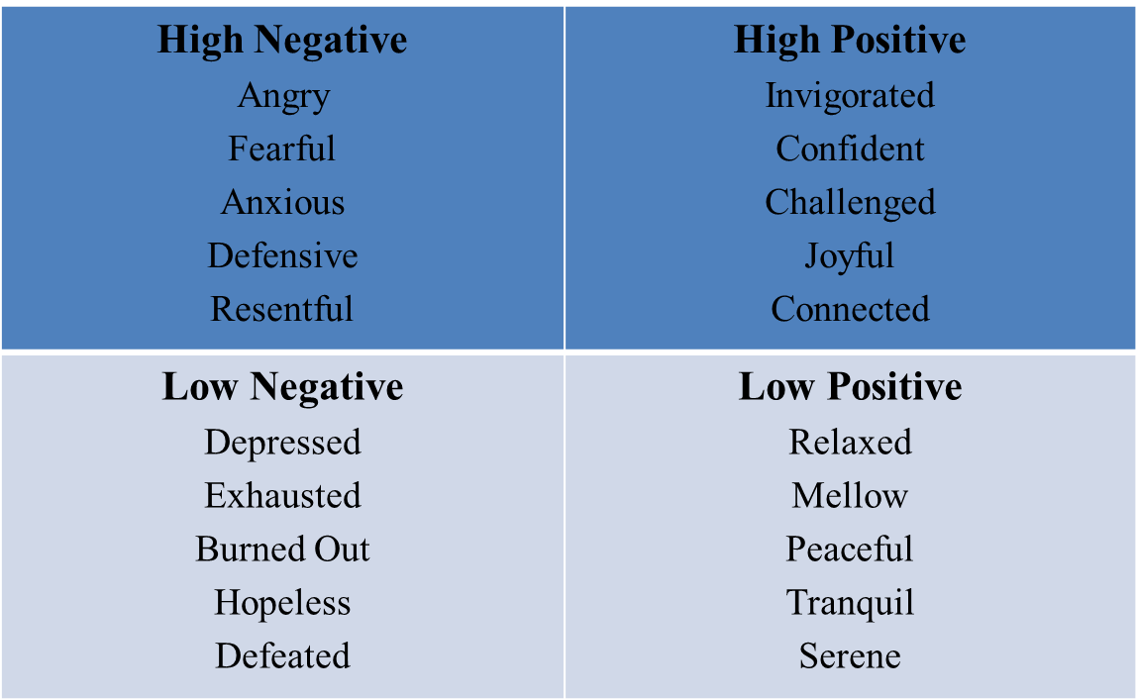
FYI - Dynamics of Energy Exchange

Slide 13
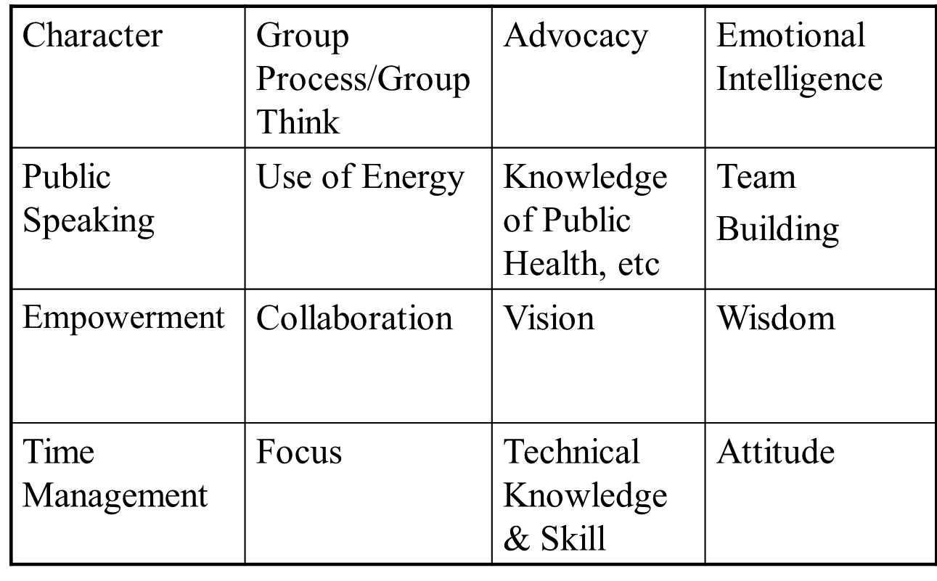
Principles of Leadership

Slide 14
Professionalism Boundaries
Relationships
Communications
Self Disclosure
Exploitation
Breaches of Confidentiality
Management of Workplace/Home Boundaries and Emotional Baggage

Slide 15
The Seven Habits - An Overview
Habit 1: Be Proactive: Principles of Personal Choice
Habit 2: Begin with the End in Mind: Principles of Personal Vision
Habit 3: Put First Things First: Principles of Integrity & Execution
Habit 4: Think Win/Win: Principles of Mutual Benefit
Habit 5: Seek First to Understand, Then to be Understood: Principles of Mutual Understanding
Habit 6: Synergize: Principles of Creative Cooperation
Habit 7: Sharpen the Saw: Principles of Balanced Self-Renewal
Source: Stephen Covey, 1989

Slide 16
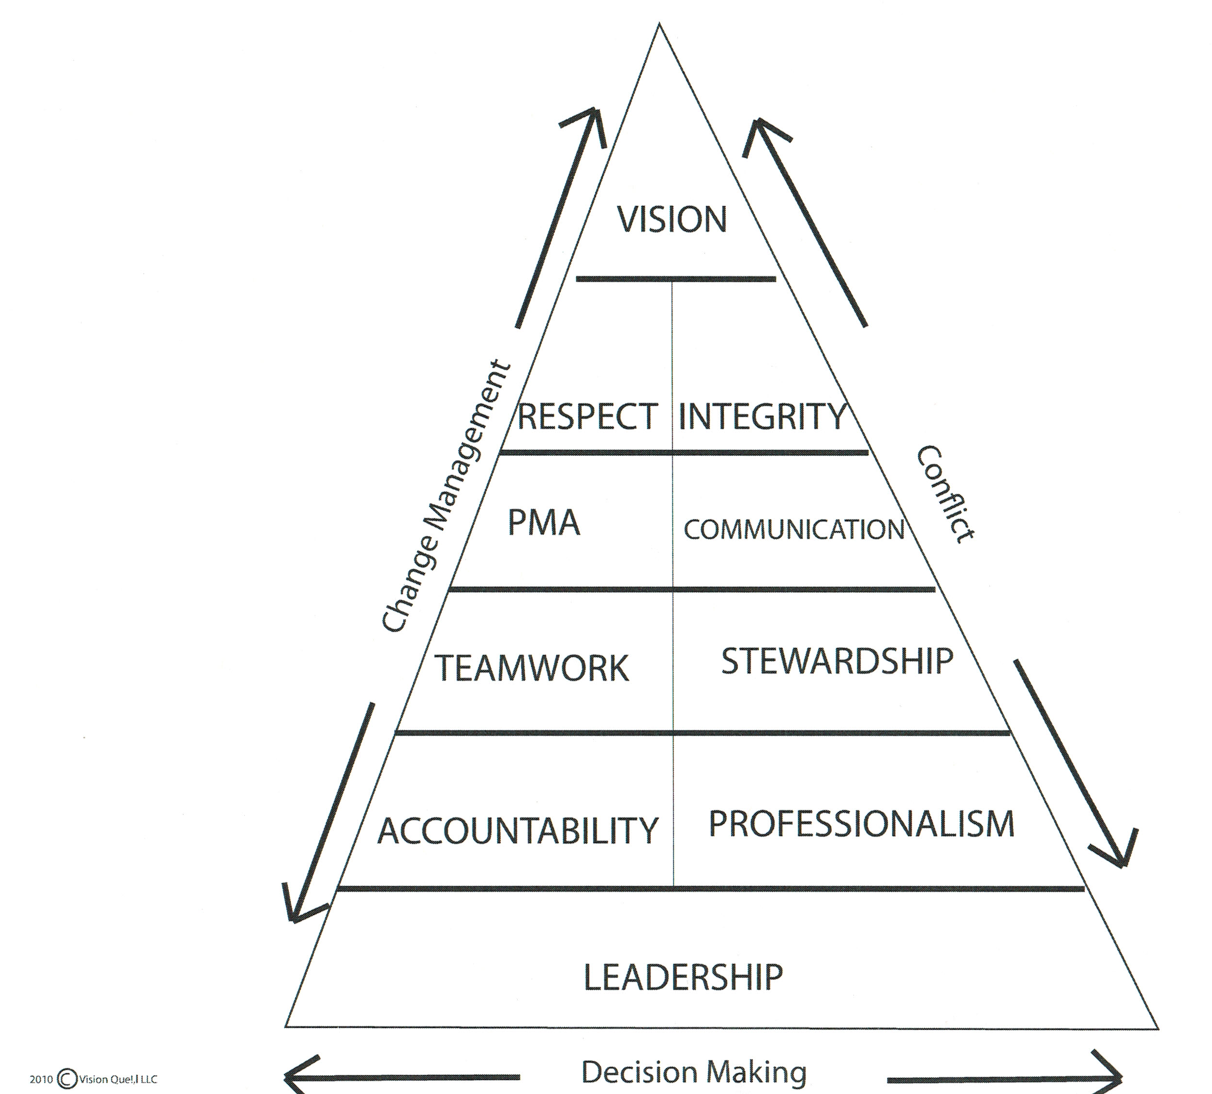

Slide 17
Workplace ‘rudeness’ is on the rise...
workplace civility has fallen in the past 10 years
technology allows workers to “zap people anonymously”
men are 7 times more likely to be rude or insensitive to underlings than to superiors
Source: Christine Pearson (1999) “Workplace Incivility: The Target’s Eye View”, University of North Carolina.

Slide 18
Communications

Slide 19

Communications
Buzz Groups:
  How much of communications is about:
    Professionalism
    Skill(s)
    Relationship(s)

Slide 20
Sample Business Etiquette
Teaching Etiquette to Adults and Business Professionals
  This two-day program presents information to enable participants to learn about first impressions and dress, body language and nonverbal communication, communication skills, civility, networking, and business dining skills.
  * A sample program for illustration purposes.

Slide 21
Sample Business Etiquette
Our business etiquette training programs are customized for your specific needs and cover a wide range of topics including the importance of attitude, nonverbal and verbal communication guidelines, forms of address, telephone and email etiquette and more

Slide 22
Sample Business Etiquette
Training Topics include:
  The Message your attitude sends
  Communication and Body language
  Office Etiquette
  Business Gifts
  Telephone skills
  Meeting Etiquette
  Electronic Etiquette
  Grasping Company Culture
  Business Travel

Slide 23
Abrasive and Abusive Conduct...
silence
glaring eye contact: “the look”
brevity or abruptness
snubbing or ignoring others
insults and put
Ryan and Oestreich (1998)
blaming, discrediting & discounting
an aggressive, controlling manner
threats about the job
yelling & shouting
angry outbursts or loss of control
physical threats

Slide 24

Thank You
Phone: (202) 460-1407
E-mail: Visionque@netzero.com
Skype: Jacqueline.coleman777
Website: www.visionquellc.com﻿

