Slide 1

Paths to Leadership: Managing Change and Challenge
Julie M. Scofield, Executive Director
Minority Leadership Program
July 9, 2013

Slide 2
Welcome to the Land of Acronyms
NASTAD ECHPP NGA
NHAS CAPUS FOA
ACA DHAP ADAP
HHS DSHAP PACHA
CMS DVH CHAC
CDC NCHHSTP BPHC
HRSA MAGI HAIIG
SAMHSA OGAC ONAP

Slide 3
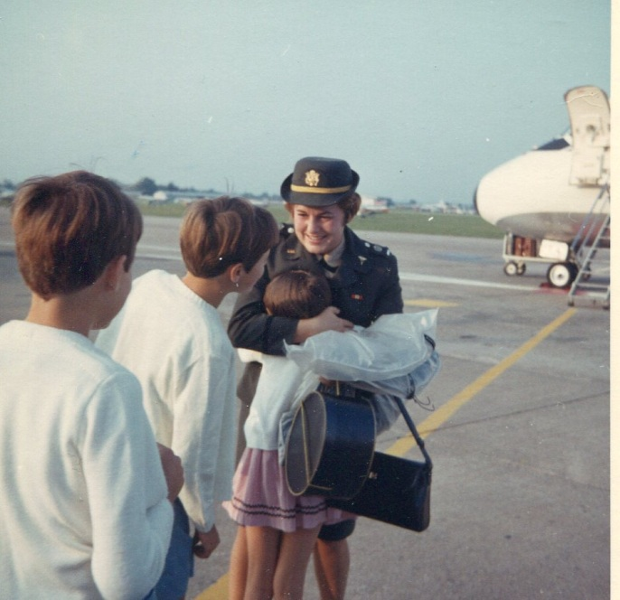

Leadership Journey

Slide 4



Fortuitous Encounters

Slide 5


Fortuitous Encounters
Buffalo State College
NASTAD
US House of Representatives
New York State Office of Federal Affairs

Slide 6
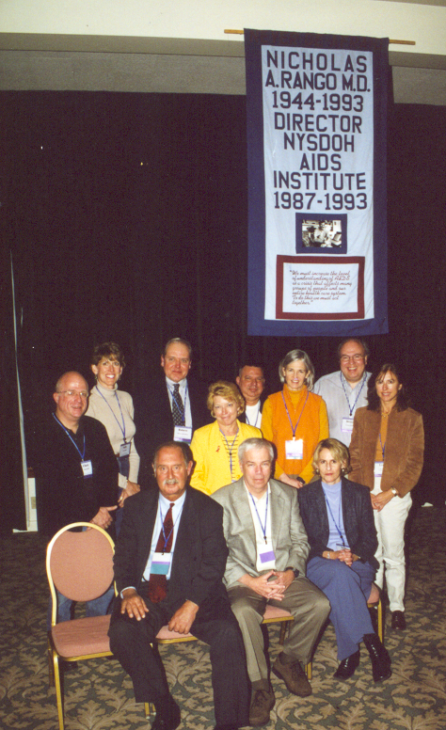
Leadership Journey

Slide 7
Fortuitous Encounters
“You are the protectors…. We’re not a bunch of bureaucrats, and if we are, we should move on. We are self selected because we want to make a difference in this epidemic. People living with AIDS and those at risk need you. They don’t need to you to be nice, all the time, and they don’t need you to be polite, all the time. They need you to be tough when you have to be, and they need you to be unyielding, when you have to be, and they need you to be decisive in deciding how this damn epidemic has gotta be controlled. Because I believe you guys got the expertise – nobody else, not higher not lower.”
Nick Rango, 1993 NASTAD Annual Meeting

Slide 8
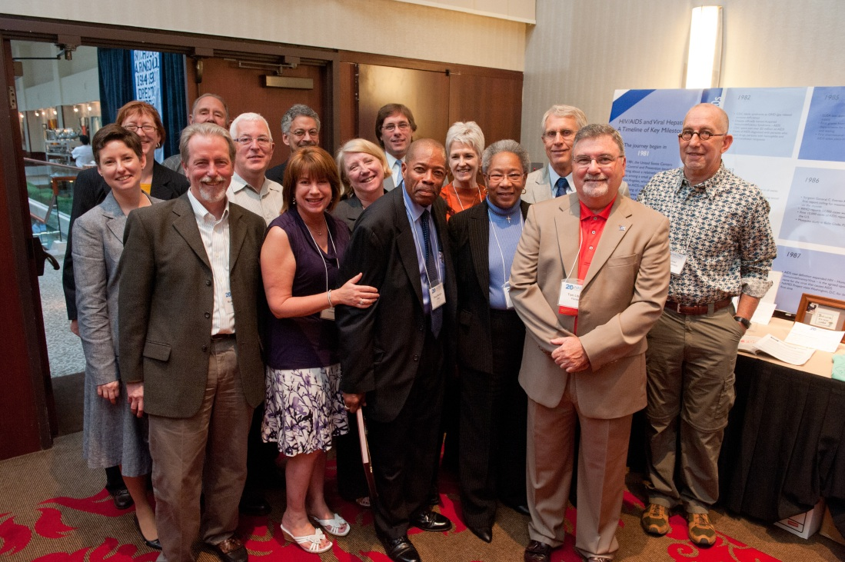
Leadership Journey

Slide 9
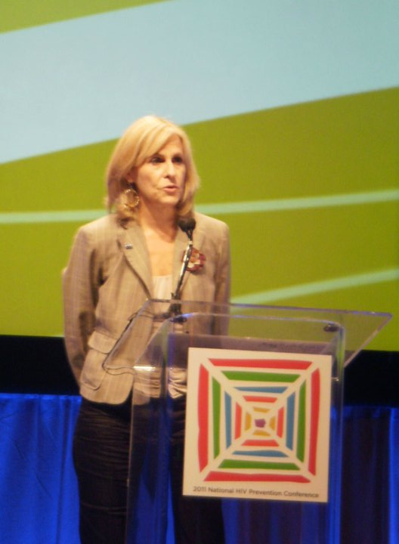
Change and Challenge
Organizational Change and Challenge
  Periods of rapid growth
  Staff alignment
  Member engagement
Policy Change and Challenge
  Ryan White reauthorizations
  Giving voice to the states
  Speaking truth to power
  Strategy

Slide 10
Leadership Advice
  Hire talent (Energy and attitude count a lot!)
  Power (The more you share the more you have.)
  Conflict (Figure out your relationship to conflict and ways to address conflict that work.)
  Trust (Quiet meetings may be a warning sign.)
  Integrity (Play by the rules or at least bend them for a good reason.)
Place, People, Right Work,
and Purpose

Slide 11

Find Your Calling
  Gifts
  Passion
  Values
  Calling

Slide 12
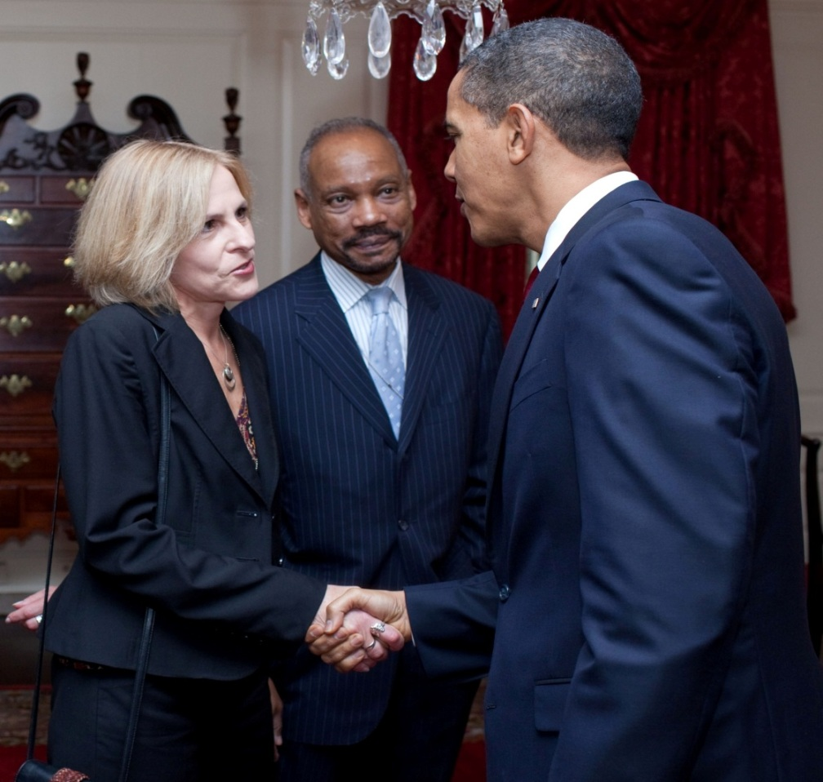
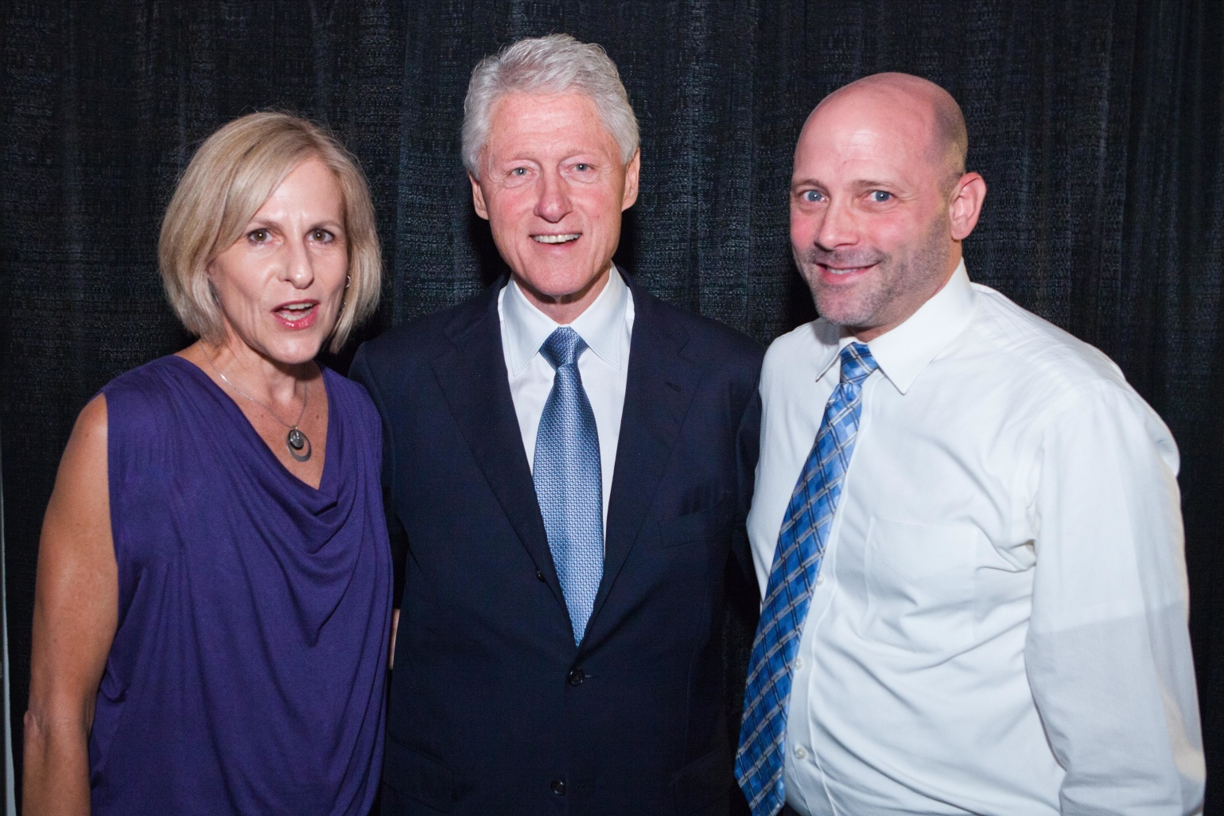
Leadership Journey

