Slide 1
Leadership Development in the Public Sector A Personal Perspective Minority Leadership Program NASTAD, Washington, DC July 8-10, 2013
By Humberto Cruz Consultant

Slide 2
What is to be covered?
The “elephants in the room”
Leadership in the abstract
Is a leader born or made?
Five myths about Leadership
Who is a minority?
Overview of the USA Workforce
People of color share of the USA labor force
Leadership in a Changing Public Sector
Why do we need to develop minority leadership in the public sector?
Similarities and differences between the public and the private sector
Stigma and discrimination in the public sector
Some personal stories/outcomes
Critical skills on becoming a leader in the public sector
Maximizing leadership opportunities within the public sector
Lessons learned
Questions and answers (discussion 15 minutes)

Slide 3
The “Elephants” in the Room
Ownership to the term minority
Entitled to a good job because of the minority status
No need to further education nor skills
Knowing it all
Taking all the credit
Opinions nor support of others are needed
Minorities are not as a smart or intelligence as the prevalent culture
There is only my way
You speak funny, therefore you are not smart
The chip in the shoulder
Minorities cannot be leaders

Slide 4
Leadership in the Abstract
Leadership is the true bedrock of an organization
“A leader is somebody that can accomplish four things: inspire, be strategic, direct and can gather people along common objectives”.
“A leader is somebody that is naturally sought by people to provide guidance or direction; somebody whose actions others want to emulate as these are seen as good.”

Slide 5
A Leader: Born or Made
There may be some born characteristics that help/hinder on becoming a leader
Can be learned and developed
Through experience
Through facing adversity
By finding a cause
First steps in leadership development
What do I want to do?
Why?
Examine how we influence others
Auto-reflection
Desire for a Personal transformation
Connection to others

Slide 6
Myths About Leadership
I cannot influence because I do not have a high level position
As soon as I get a position of power, people will follow me
When I get to the top I will have control
When I get to the top I will have no limits
If I do not get to the top, I will not try to influence

Slide 7
Who is a Minority?
Race/ethnicity
Gender
Religion
Sexual orientation
Political affiliation
Age
Socio economic status
Disability
Language
Geography
History

Slide 8
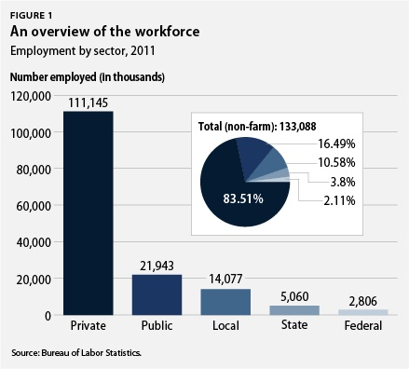
An Overview of the USA Workforce
Total Working pop: 243 M
Working/seeking emp: 155 M.
Currently employed: 142 M
Unemployed: 8.2 %
Employed In the Public Sector
Municipal Gov : 10.58 %
State Gov: 3.8 %
Federal Gov: 2.11 %

Slide 9
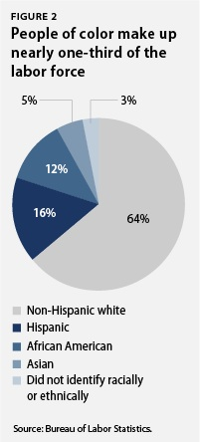
People of Color Share of the USA Labor Force
People of color make up 36% of the labor force
Women account for 47 of the labor force
Women of color make 33 % of the workforce
Diversity is lacking in senior level positions of the federal government

Slide 10
Leadership in a Changing Public Health System
The increased demand on public health departments to perform better and improve health outcomes with less funding drives systemic change and leadership development
Leadership development is an important predictor of the transformational change in the public system

Slide 11
Minority Leadership: A must!
To participate in the government process
To identify needs and gaps in service
To provide a voice, opinion and participation in decisions impacting our communities
To set policy
To set resource allocation
To develop and implement programs
To make sure needs are addressed effectively
To assess quality
To help eliminate disparities

Slide 12
Public vs. Private Sector
Similarities
Differences
Goal oriented
Complex structure
Government body
Ruled by a set of policy/procedures
Need money/resources
Serve people/sell product
Use human resources
Bureaucratic
Centralized
Hierarchy
Top down communication
Lack of reward
Ruled by a Political environment
Profit oriented
Cult to the individual
Competitiveness
Hiring Practices
Quality control
Set of laws and regulations
Services offered

Slide 13
Stigma and Discrimination in the Public Sector
It is real
Based in many factors mentioned in Slide 7
Demoralizing, humiliating, demeaning
Stigmatizing
Creates conflict
Impacts on work performance/productivity
It may be subtle
It may be institutionalized
Changing………….. but slowly

Slide 14
Some Personal Experiences
Being too successful, having to resign
Being a woman, showing who is the boss
Being gay, using it to your advantage
Being a minority, using it to your advantage
Speaking with a heavy accent, underestimated
Some of your own experiences?

Slide 15
Maximizing Leadership Opportunities Within the Public Sector
Assess your working environment
Assess your strengths and weakness
Take initiative, take charge
Meet deadlines
Make use of advancement opportunities
Take advantage of all available training
Be knowledgeable of the affirmative action rules/laws
Take Civil Service exams
Continued education
Do more than the minimum required
Identify a mentor
Network
Learn to Volunteer
Work as a team member
Keep track of your accomplishments
Maintain a list of trainings and advances
Get to be known
Offer improvement ideas

Slide 16
Critical Skills on Becoming a Leader
Solid education
Critical and strategic thinking
Communication skills
Problem solving
Being an agent of change
Systems approach
Calculated Risk taker
Questioning the status quo
Assertiveness
Team player
Taking responsibility
Innovative
Supervisory /administrative skills
Flexibility
A desire to help and improve
Give credits to others
Respect
Some degree of ambition

Slide 17
Lessons Learned
Take control of your own destiny
Know your strength and weakness
Use your perceived handicaps as your assets
Know your work environment
Seize opportunities, create the opportunities
Leave behind your prejudices and biases
Be strategic and offer alternatives
Learn from others
Develop new skills
Use all possible opportunities for advancement
Be an agent of change
Be an active listener
Think before speaking
Voice your opinions
Be empowered/empower others
Work to improve service delivery to others

Slide 18
Questions and Answers

Slide 19
Bibliography
Bernard M. Bass, Forecasting Organizational Leadership: From Back (1967)to the future (2034)
Camile Roldan Soto, Como se forma un lider, El Nuevo Dia, Febrero 21, 2012.
J. Public Health Management practice, 2010, 16(1), 72,78
Bureau of Labor Statistics, 2012
Mary Uhl-Bien, Russ Marion, Complexity leadership in bureaucratic forms of organizing: A meso model, The leadership Quarterly 20 (2009) 631-650
Humberto Cruz, Consultant, Own views and experiences, NASTAD, July 9, 2013.

Slide 20
Contact Information
Humberto Cruz,
Consultant
Former NYS AIDS Director
cruzum@gmail.com

