Slide 1

Climbing the Leadership Mountain
Minority Leadership Program
Jesse Milan, Jr., JD
July 8-10, 2013

Slide 2

Climbing the Leadership Mountain
Leadership Styles
Leadership Tiers
Leadership Scale
Leadership Tasks

Slide 3
What is Leadership?
Leadership Quote:
Leadership is not a
position. You are not
a leader because you
have the title. Leadership
is something that we
earn from followers on a
day to day basis.
The EMS Manager Newsletter

Slide 4
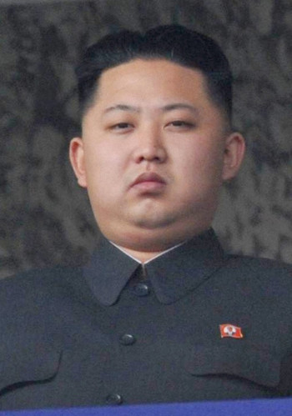
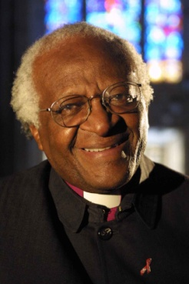
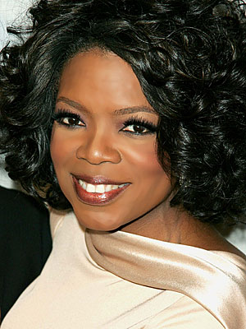
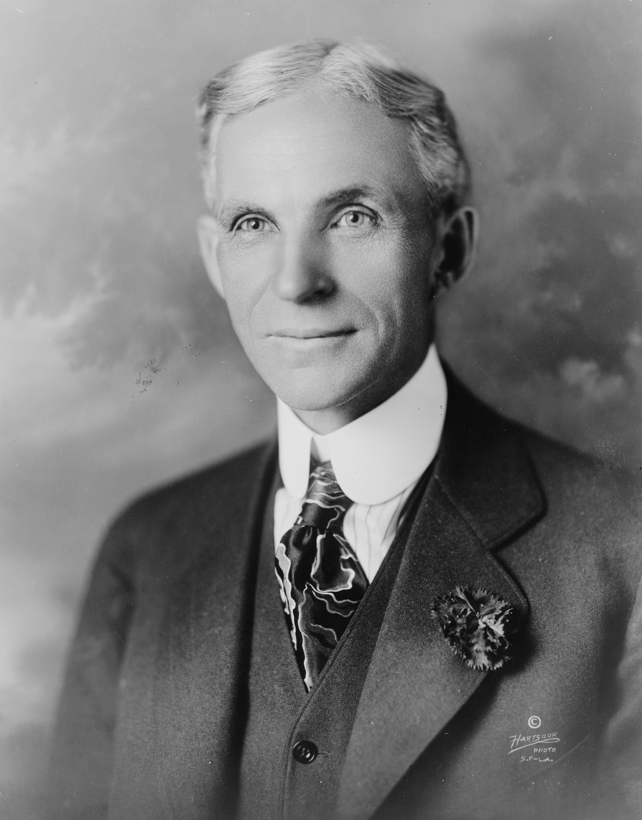
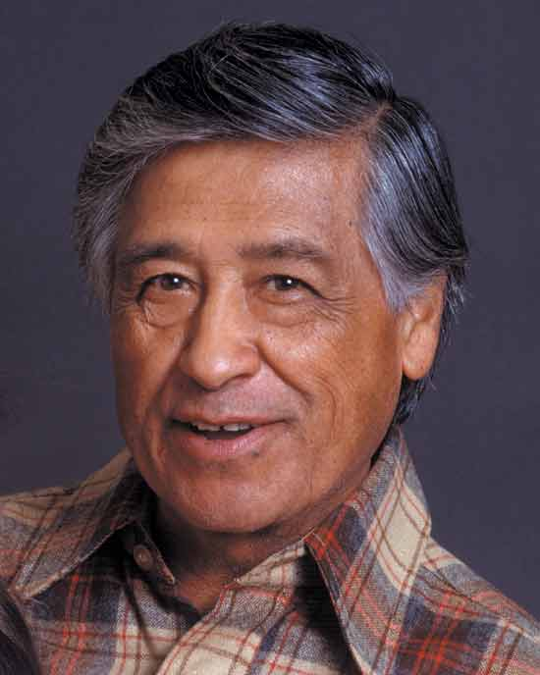
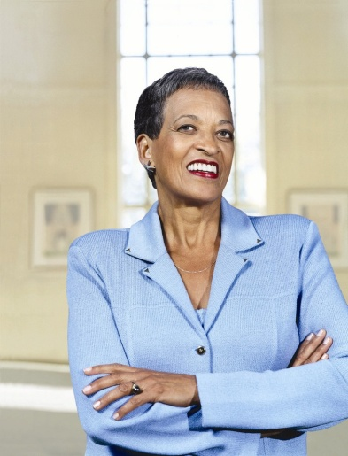
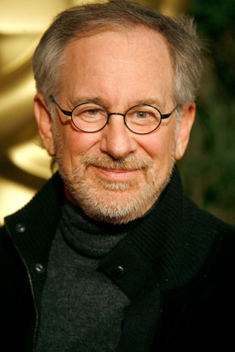
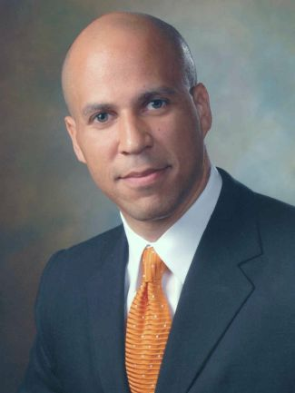
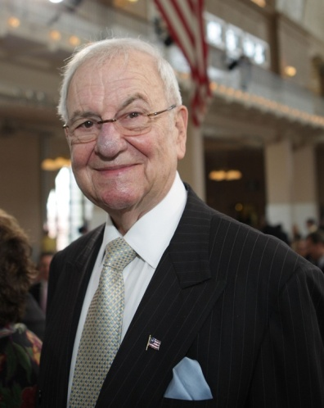
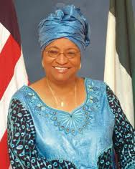
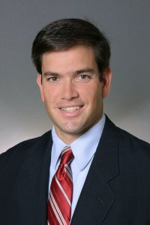
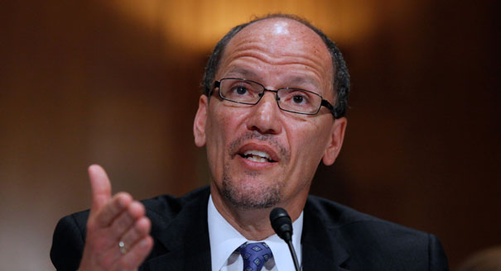
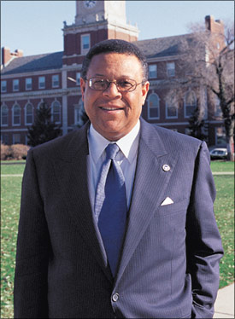
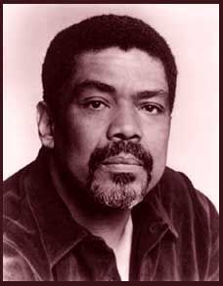
Who Are Leaders?

Slide 5

Leadership Roots
Mission
based in
Passion
and
Service

Slide 6
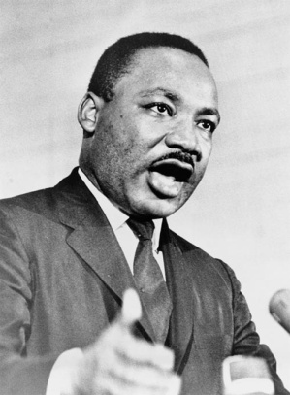
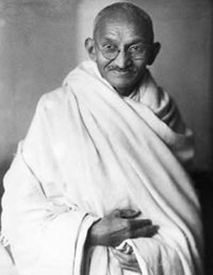
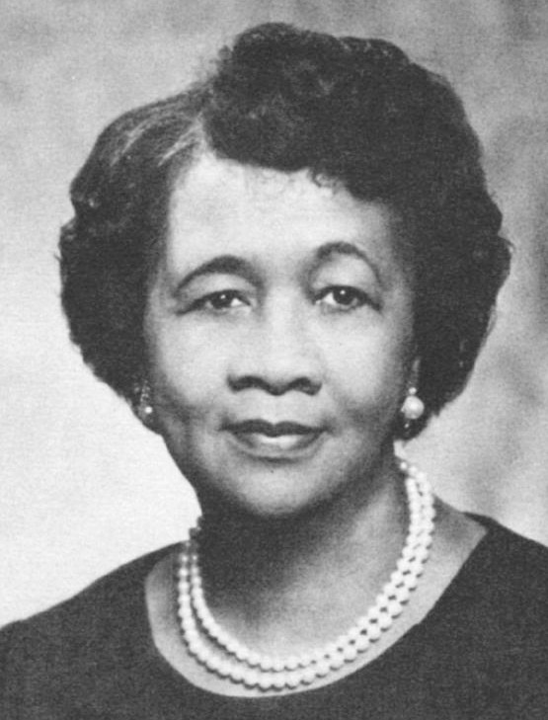

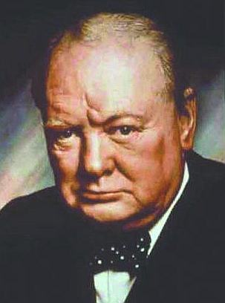
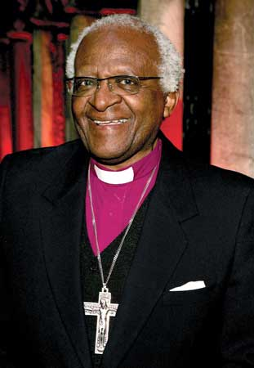
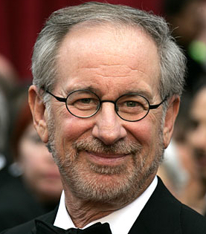
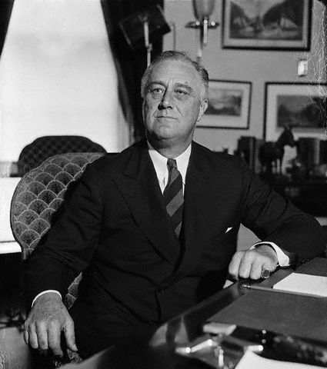
What was their passion and commitment?

Slide 7
Personal Leadership Mission:
Who I am as a leader is…
Rooted in Your Personal Passion and Commitment
What do you do to activate your passion and commitment to serve others?

Slide 8
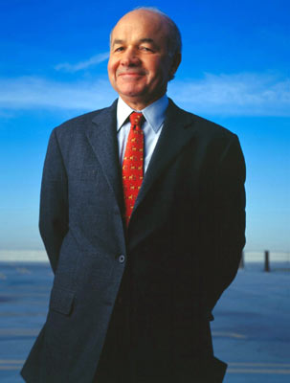
Personal Leadership Target:
Whom Do You Serve?
Leadership Quote:
If anyone desires to be first, he must be last of all, and servant of all.
Mark 9:35
Ken Lay Isn’t Listening

Slide 9
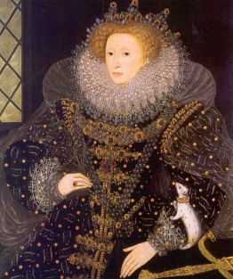
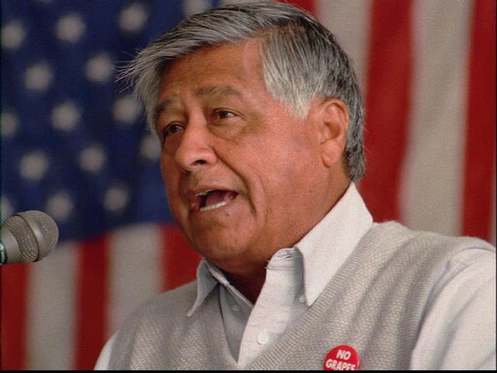
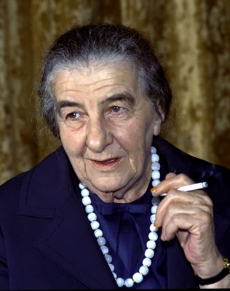
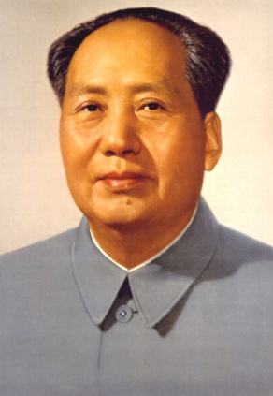
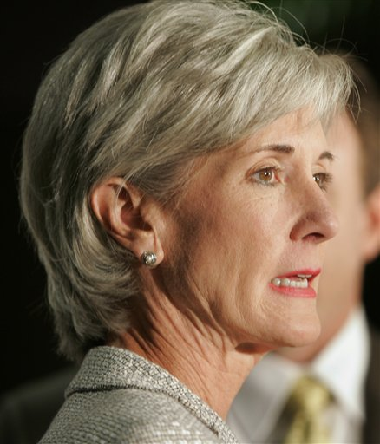
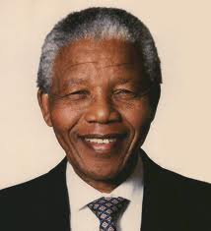
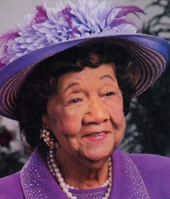
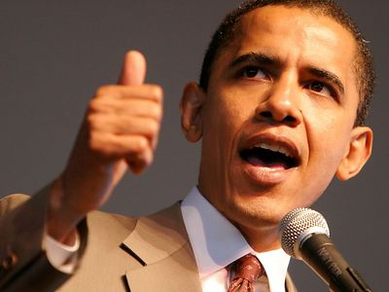
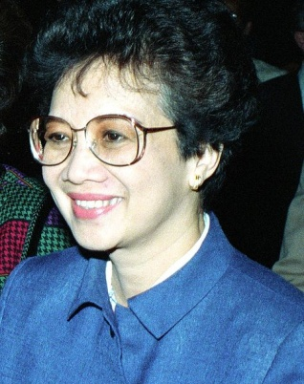
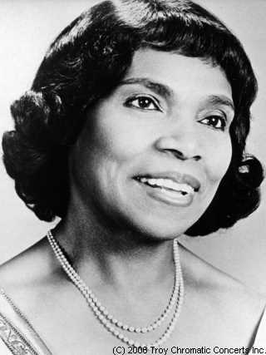
Who do these leaders serve?
Leadership should be born out of the understanding of the needs of those who would be affected by it. (Marian Anderson)

Slide 10
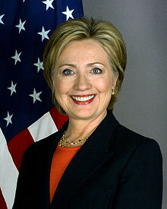
What is their personal leadership mission?
(What did they do as leaders to activate their passion/commitment for those they serve?)

Slide 11
Personal Leadership Mission:
Who I am as a leader is…
Task 1: Name Your Passion
(Ten words or less)
Task 2. Name Who You Serve
(Six words or less)

Slide 12
Personal Leadership Mission:
Who I am as a leader is…
Task 3: Write your personal leadership mission statement.
(Ten words or less)
“Who I am as a leader is…”

Slide 13

Personal Leadership Mission:
Who I am as a leader is…
Task 4: Stand and deliver your personal leadership mission statement.

Slide 14
Leadership Styles
Authoritarian or autocratic --- demand and don’t inspire
Participative or democratic --- lead as working part of a team
Delegative or Free Reign --- let others figure it out
Charismatic leader --- others depend on leader’s personality
Bureaucratic leader --- lead by “the book”
Situational leader --- lead tasks to achieve specific result
Transformational leader --- inspire change through shared values
Servant Leader --- leading to serve others

Slide 15
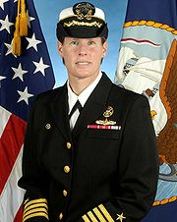
Leadership style gone wrong…
The Rise and Fall of a Female Captain Bligh

Slide 16

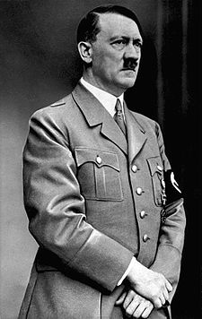
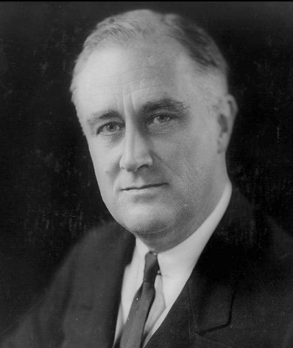
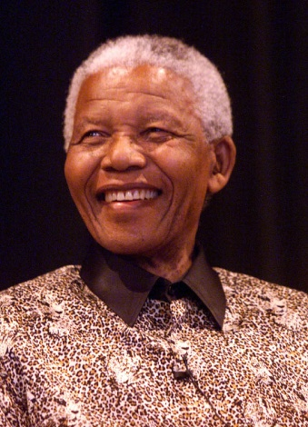
Leadership Styles
Applying some or all…

Slide 17

Earning Leadership:
Technical Competence = Respect
Leadership Quote:
Technical competence comes from being trained in the business and having experience -- experience that allows you to not only understand how the business works, but how the workers in that business need to be led. And technical competence puts you in a position of being respected by those you are leading.
Susan Davis, Leadership Blogger

Slide 18
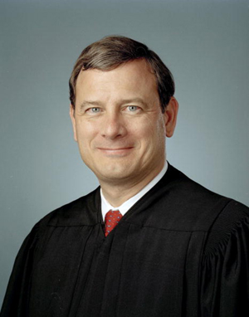
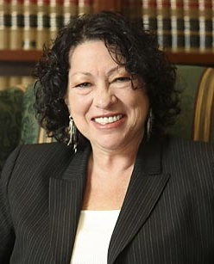
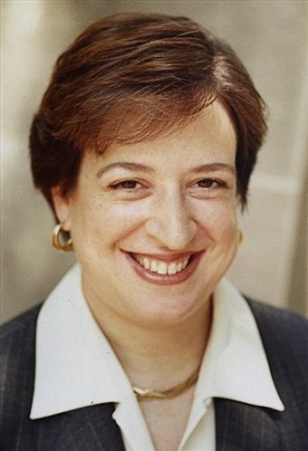
Earning Leadership:
Technical Competence
Technical competence = a grasp of one's field

Slide 19
Achieving Technical Competence:
Work, Work, Work!
Leadership Quotes:
“Leaders are not born. They are made. They are made just like anything else….through hard work.” Vince Lombardi
“Whatever your life's work is, do it well. A man should do his job so well that the living, the dead, and the unborn could do it no better.”
Martin Luther King
“Whatever you are, be a good one.”
Abraham Lincoln

Slide 20
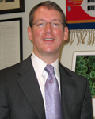

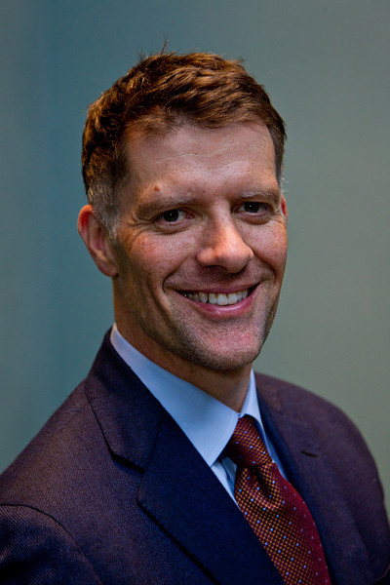
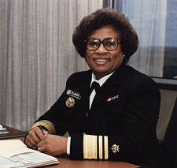
Technical Competence:
Earning Respect

Slide 21

Technical Competence:
Earning Respect
“Milan appointed AIDS Director” – July, 1995

Slide 22

Leadership Opportunities:
Management and Accountability
Leadership Quote:
The boss drives people; the leader coaches them. The boss depends on authority; the leader on good will. The boss inspires fear; the leader inspires enthusiasm.
– Steve Banhegyi & Associates

Slide 23
Manage and Be Accountable for Resources: Win Them, Don’t Waste Them t
Time --- give it, and attract others to give it
Talent --- find, employ, deploy, and teach it
Money --- find it, spend it, use it wisely
Goodwill --- cultivate it, do not abuse it

Slide 24
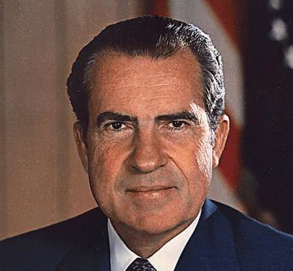
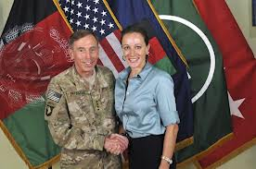
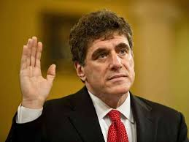
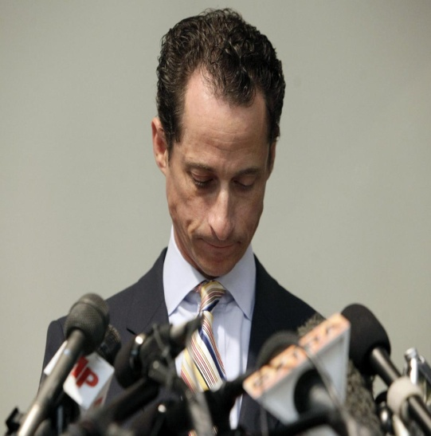
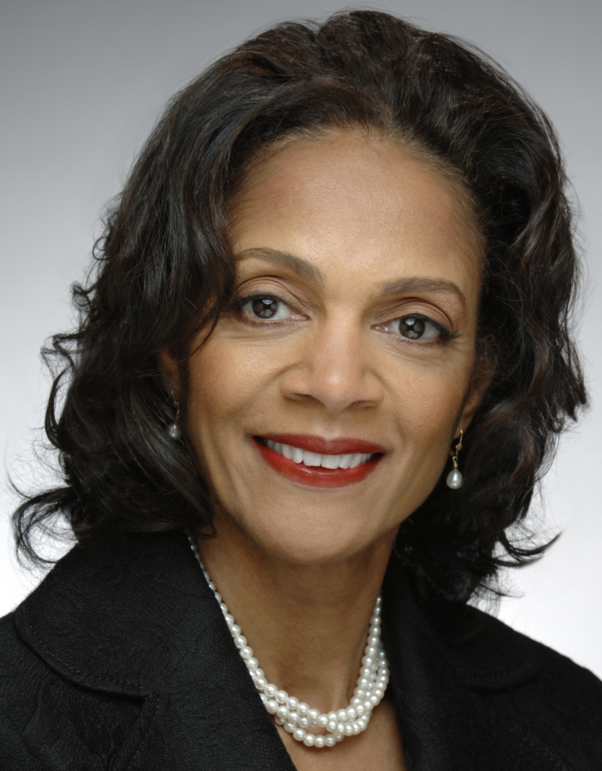
Management and Accountability:
Leadership Opportunities Won and Wasted

Slide 25

Leadership Peak: Vision
Vision = future state of being of those you serve
Where there is no vision, the people perish.
Proverbs 29:18
“A leader is a dealer in hope.”
Napoleon Bonaparte

Slide 26
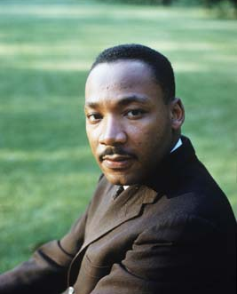
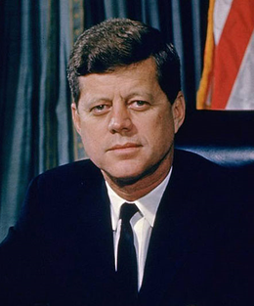

Leadership Peak: Vision
I have a dream…..
Vision = A future state of being of those you serve

Slide 27

Leadership Peak: Vision
“The United States will become a place where new HIV infections are rare and when they do occur, every person regardless of age, gender, race/ethnicity, sexual orientation, gender identity or socio-economic circumstance, will have unfettered access to high quality, life-extending care, free from stigma and discrimination.”

Slide 28

Climbing the Leadership Mountain

Slide 29

The Sliding Scale of Leadership
Strategy and Execution: Responsibilities change
day to day,
moment by moment,
need by need,
task by task.

Slide 30

The Sliding Scale of Leadership
Strategy and Execution

Slide 31


The Sliding Scale of Leadership
Leadership needed
state by state….

Slide 32

You Will Climb to the Top

Slide 33
Thank you!
Jesse Milan, Jr., JD
Altarum Institute Fellow and
Leadership and Public Health Consultant
jmilanjr@verizon.net
Jesse.Milan@altarum.org
(202) 870-7208

